Slide 1

Factories Operational Insights Dashboard
Downtime Analysis Overview

Slide 2

Dashboard Purpose
This dashboard provides insights into factory downtime and device health. It helps identify which factories and machines experience the highest downtime, so management can focus on maintenance and efficiency improvements.

Slide 3
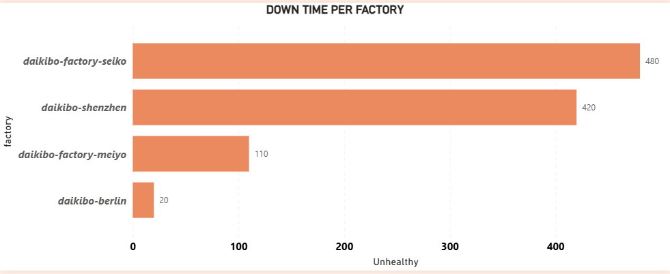
Downtime per Factory
Daikibo Factory Seiko has the highest downtime (480 unhealthy hours), followed by Daikibo Shenzhen (420). Berlin shows minimal issues, indicating better operational stability.

Slide 4
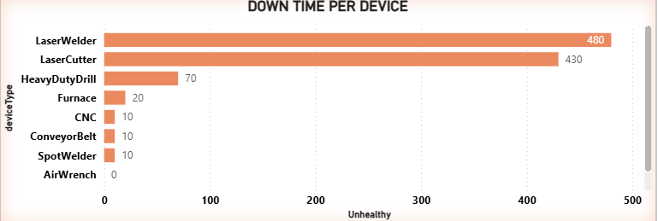
Downtime per Device
Laser Welders and Laser Cutters contribute most to downtime. These machines should be prioritized for inspection, servicing, or replacement.

Slide 5
Conclusion
The dashboard clearly highlights that Daikibo Factory Seiko and Shenzhen are experiencing the highest operational downtime, which directly impacts production efficiency.
At the equipment level, Laser Welders and Laser Cutters are the biggest contributors to downtime, making them critical focus areas for maintenance and performance improvement.
By prioritizing these factories and high-risk devices, the company can reduce unplanned outages, improve machine reliability, and increase overall production output.
This dashboard enables management to make data-driven decisions for maintenance planning and operational optimization.

